Slide 1
About Me
College: United States Air Force Academy
Major: Mathematics
Hometown: Austin, TX
Hobbies: Skiing, gliding, soccer
Interesting Fact: I have been on HGTV

Slide 2
Architecting with Information Theory
Connor Kordes
July 10, 2019

Slide 3
Motivation/Scope
Traditionally, new architectures are developed considering a single intelligence type
Performance modeling specific to an ‘INT’ (GEOINT, SIGINT, etc.)
New architectures are not assessed within a multi-INT enterprise
Measuring the value of each ‘INT’ type within an enterprise is difficult
No standardized metrics across ‘INTs’
Lack of common value metrics leads to stovepiped/traditional designs
Information Theory provides metrics agnostic to ‘INT’ type
Information value of a sensing agent measured in Shannon Bits
Shannon Bit can be compared across various sensing agents
More bits are better
Implemented Harney information equations, a reformulation of Johnson’s criteria which was built on Shannon’s seminal work on information theory (see Works Cited chart for reference)

Slide 4
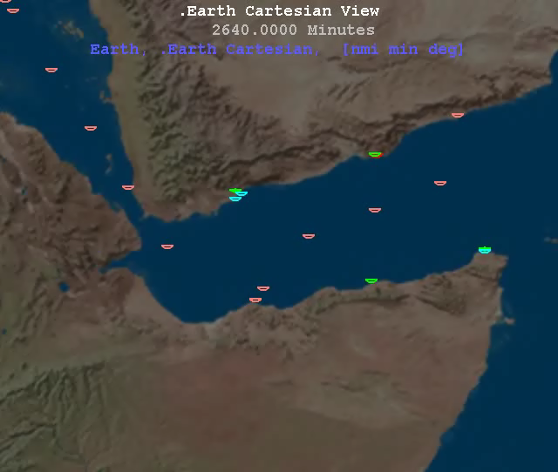
Problem Formulation
Problem Statement
Design a LEO architecture to maximize the amount of information, in terms of access and resolution, that can be collected against a Somali Pirate Scenario.
Objectives
Maximize Probability of Access to each event in the scenario
Maximize total amount of information bits collected on the scenario
Minimize number of satellites
Minimize altitude of satellites
Maximize number of sensors
Decision Variables
Number of satellites (1-10)
Circular LEO orbit parameters (SMA, INC, RAAN, MA)*
Sensor type for each satellite (informed by list of commercial sensors)
Parameters/Constraints
Somali Pirate Scenario
Defines number of entities, locations, velocities, and activity state
Currently generated as a deterministic scenario
In the future (TBD) will randomly generate with repeatable random seed
*SMA – Semi-Major Axis; INC – Inclination; RAAN – Right Ascension of Ascending Node; MA – Mean Anomaly
Notes:
(U) The specific goal of this study is to design a LEO architecture to maximize the amount of information collected against a Somali Pirate Scenario. The primary objectives are to maximize PA-EE for event durations defined by the pirate scenario as well as the information collected on targets in the scenario. A secondary objective is to minimize the number of satellites to achieve designs with the highest information content and the fewest satellites possible.
(U) The decision space shall be the number of satellites in the constellation (less than 10), the orbital parameters of the constellation (restrict to circular orbits, and an argument of perigee of zero), and the sensor type assigned to each satellite.
(U) Each architecture selected by GRIPS will be evaluated against a single instantiation of the Somali Pirate Scenario. This provides the number of entities, locations, and other observables in the scenario. As a follow on to this work, architectures may be evaluated against multiple instantiations of the Somali Pirate Scenario, however we are limiting this first step at one.

Slide 5
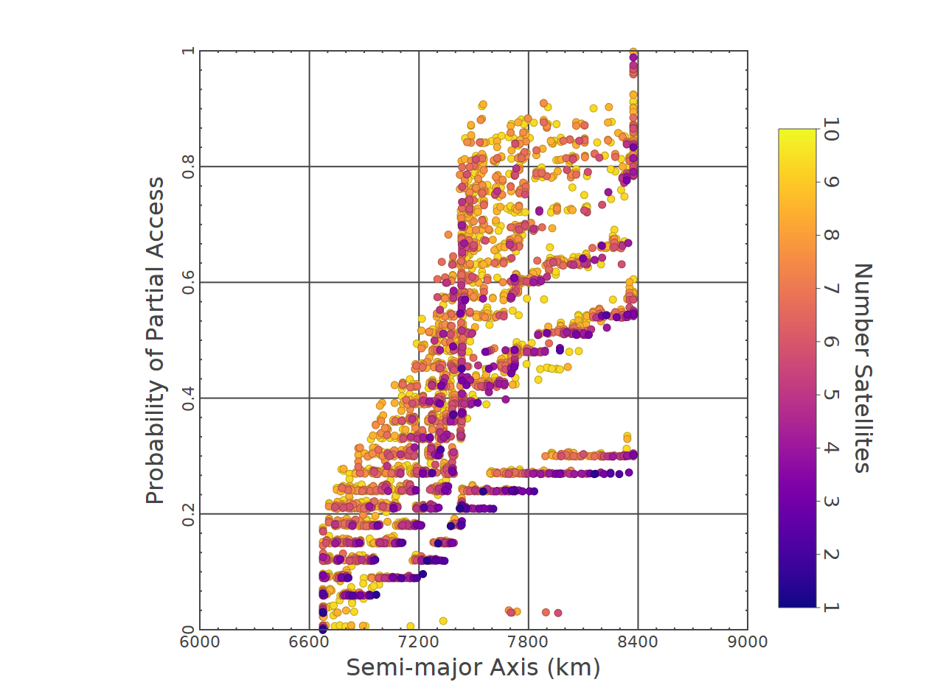
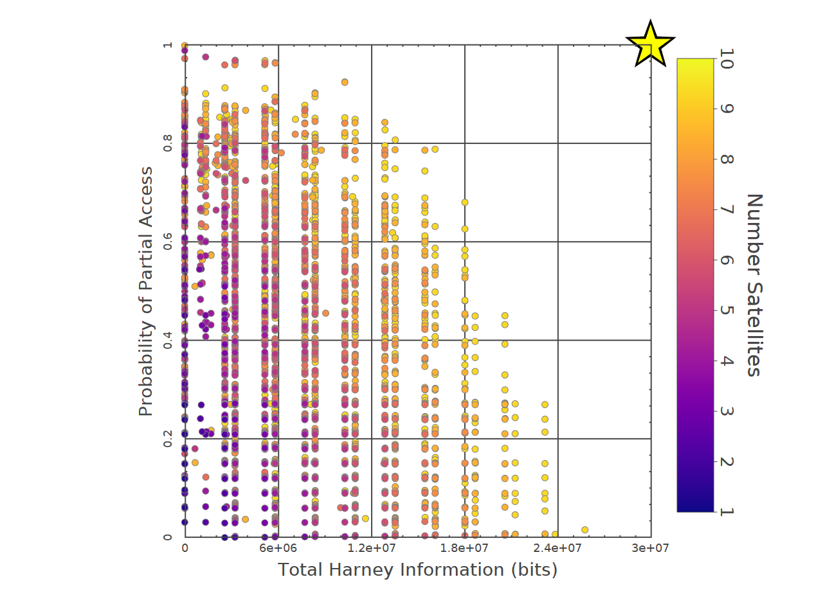
Preliminary Results: GRIPS
Validation of expected trends
Access Metrics vs. Constellation Semi-major Axes
Access Metrics vs. Number of Satellites
New Results
Information Metric vs. Probability of Access

Slide 6
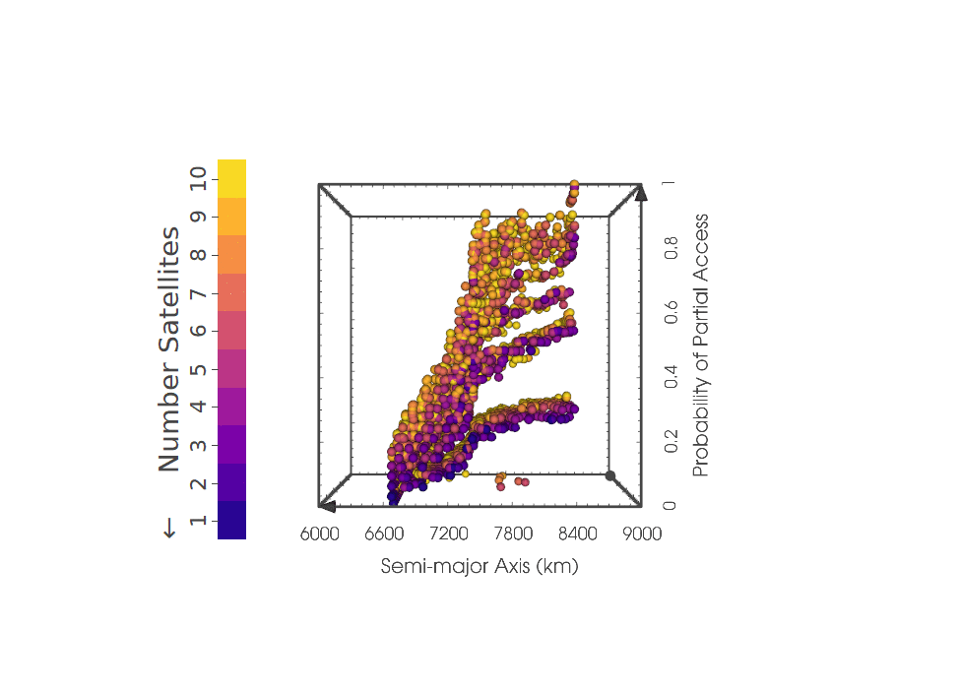

Preliminary Results
DiscoveryDV
Quick insights and understanding of the data through high-dimensional plotting tool
Information and Number of Satellites
The third axis and color mapping clarify the tradeoff between these two objectives
Information and Access
The cascade of the data along information highlights this trend

Slide 7
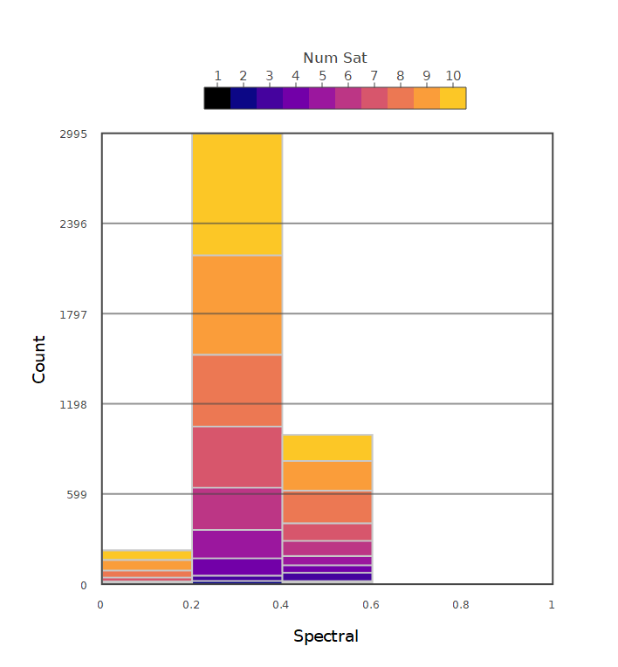
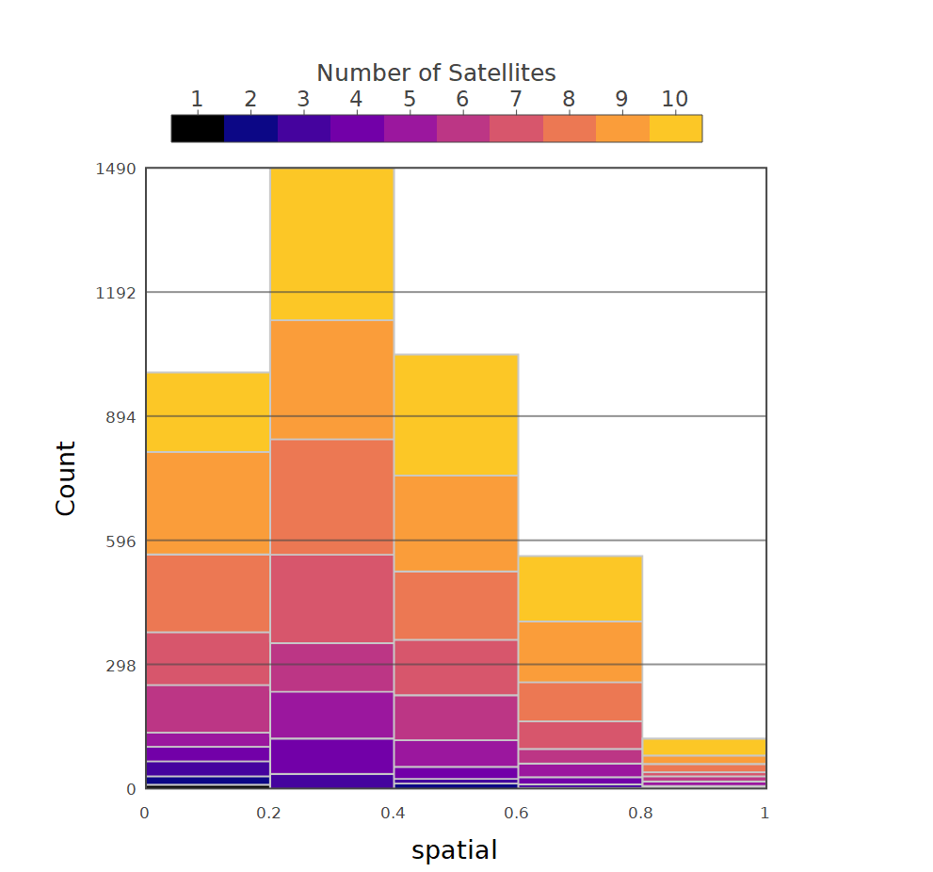
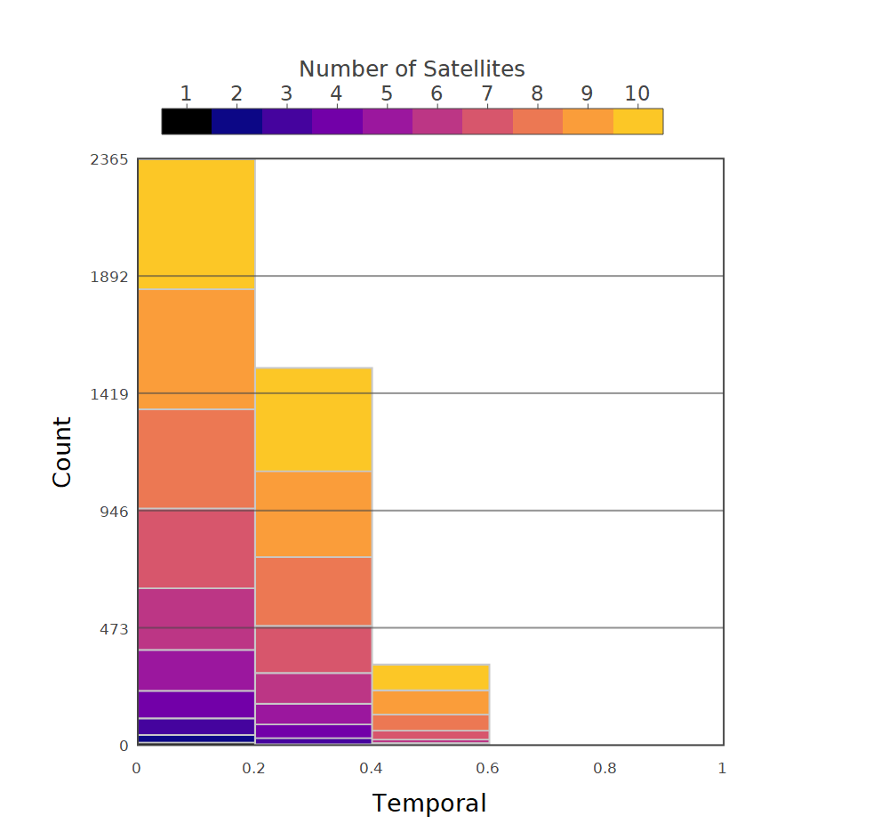
Preliminary Results: GRIPS
Information Mapping
Spatial
Spectral
Temporal
This mapping creates a better understanding of the solutions

Slide 8
Key Takeaways
The model is performing as expected
Objectives (altitude, information, access, and unique sensors) are providing feasible solutions
Improved Access Metric Formulation
There is a tradeoff between Information and Probability of Access
Conventional approaches miss solutions
Integrated constellations need more than an access metric
Future models need to better account for the different information types

Slide 9
Future Steps
Project
Address bias towards spatial data
Resulting architecture designs should balance spatial, spectral, and temporal information gain
Expand ground truth scenario
Different locations
Different scenario types
Address real life complexities
Staleness of information
Not all information is equal
A refined metric for cost of sensors
For me
Back to Academy
Gliding Instructor Pilot
Singapore
Hopefully Graduate School

Slide 10
Works Cited
Ahmed, Mohiuddin, and Gregory Pottie. "Fusion in the context of information theory." Distributed Sensor Networks (2005): 419-436.
August, Peter, and Y. Q. Wang. “Resolutions of Remote Sensing.” University of Rhode Island, 2009.
Ferringer, Matthew P., Ronald S. Clifton, and Timothy G. Thompson. "Efficient and accurate evolutionary multi-objective optimization paradigms for satellite constellation design." Journal of Spacecraft and Rockets 44.3 (2007): 682-691.
Franklin, Steven E., and Clayton F. Blodgett. "An example of satellite multisensor data fusion." Computers & Geosciences19.4 (1993): 577-583.
Grönwall, Christina, et al. "Future electro-optical sensors and processing in urban operations." Electro-Optical Remote Sensing, Photonic Technologies, and Applications VII; and Military Applications in Hyperspectral Imaging and High Spatial Resolution Sensing. Vol. 8897. International Society for Optics and Photonics, 2013.
Harney, Robert C. "Information-based approach to performance estimation and requirements allocation in multisensory fusion for target recognition." Optical Engineering36 (1997).
Howerton, Phil. Managing Uncertainty and the Practice of Intelligence, [PowerPoint slides], 2019.
Jakob, Michal, et al. Adversarial modeling and reasoning the maritime domain year 1 report. Technical report, ATG, CTU, Prague, 2009.
Jakob, Michal, et al. Adversarial modeling and reasoning the maritime domain year 2 report. Technical report, ATG, CTU, Prague, 2010.
Liang, Shunlin. Comprehensive Remote Sensing. Elsevier., 2018.
L. Roux and J. Desachy, "Information fusion for supervised classification in a satellite image," Proceedings of 1995 IEEE International Conference on Fuzzy Systems., Yokohama, Japan, 1995, pp. 1119-1124 vol.3. doi: 10.1109/FUZZY.1995.409823
“THE CEOS DATABASE : MISSION, INSTRUMENTS AND MEASUREMENTS.” THE CEOS DATABASE : MISSION, INSTRUMENTS AND MEASUREMENTS, 2019, database.eohandbook.com/.

Slide 11
BACKUP

Slide 12
Ground Truth Scenario
Purpose: Create a test ground problem for creating optimal satellite constellation designs
Test problem simulates piracy of commercial merchant ships off the coast of Somalia, well studied in open literature*
Pirate model:
Merchant ships with a set of observable characteristics (i.e., length, color, AIS) travel along a known path
Pirate ships with a set of observable characteristics (i.e., length, color) may ambush merchant ships along path
Scenarios generated with Finite State Machines
Given specific scenario(s), apply GRIPS to design an architecture to maximize information bits and maximize probability of access
Decision Variables:
Sensor on each vehicle
LEO orbit parameters
Objectives:
Probability of Access of an Event (max)
Information Collected (max)
* Jakob, Michal, et. al. Adversarial modeling and reasoning in the maritime domain year 1 report. Technical report, ATG, CTU, Prague, 2009.
Jakob, Michal, et. al. Adversarial modeling and reasoning in the maritime domain year 2 report. Technical report, ATG, CTU, Prague, 2010.

Slide 13
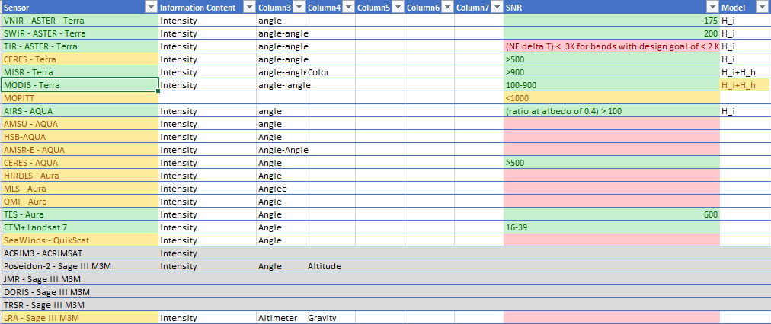
Preliminary Results: Sensor Data

Slide 14
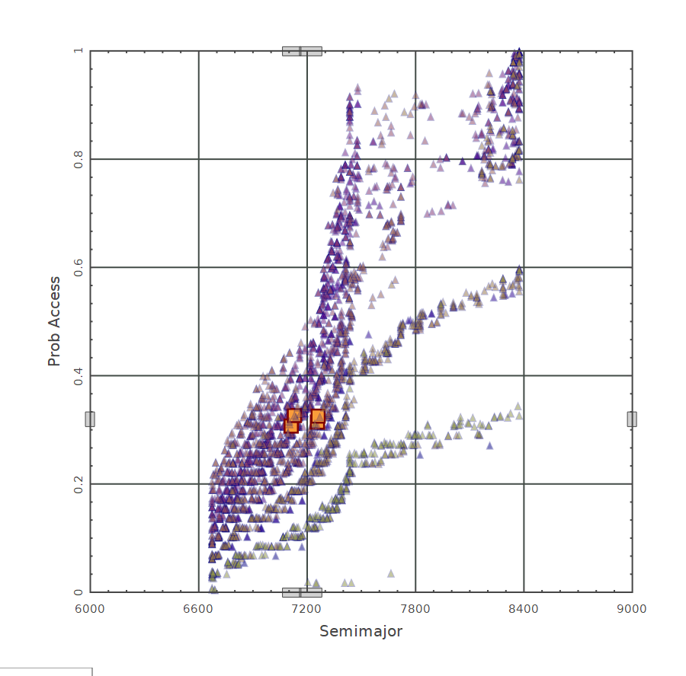
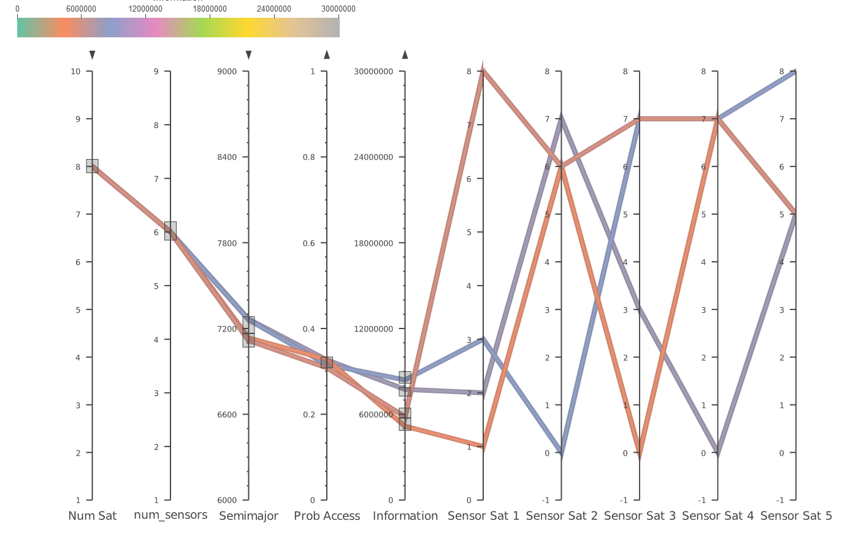
Preliminary Results: Sensor Profiles
Total Information
Probability of Access
Semi-major Axis

Slide 15
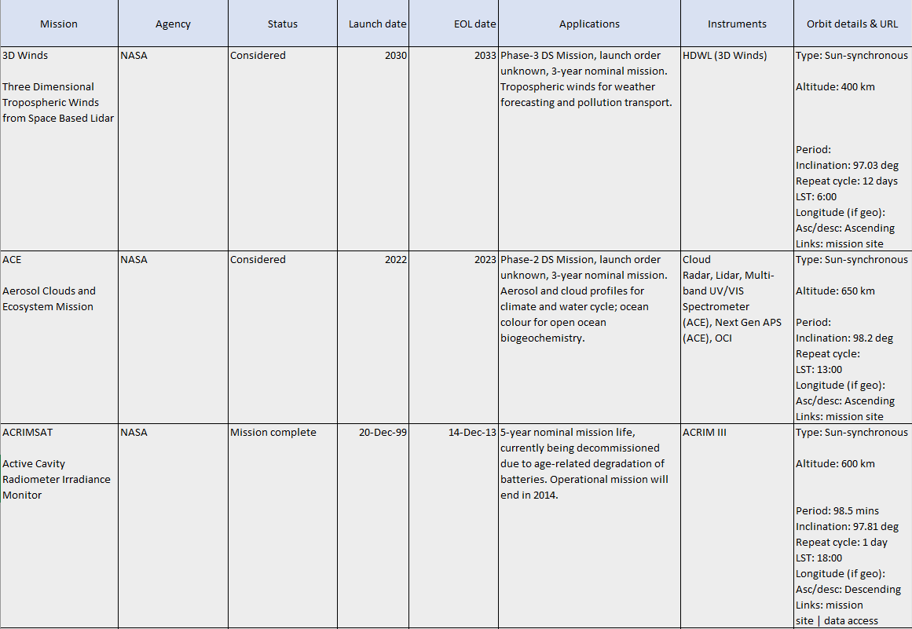
Preliminary Results: Sensor Data

Slide 16
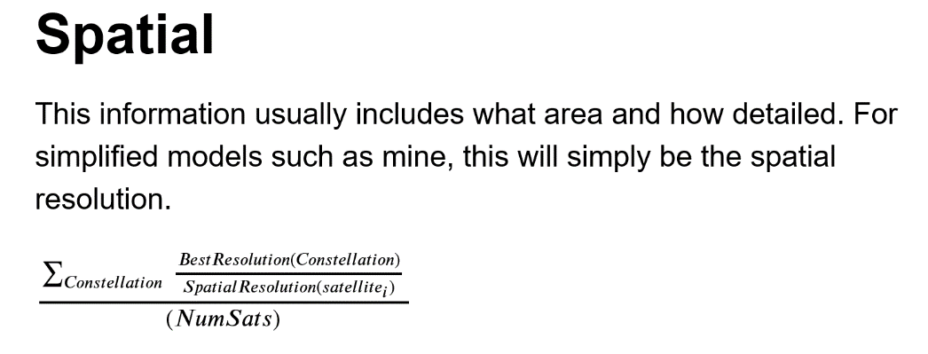
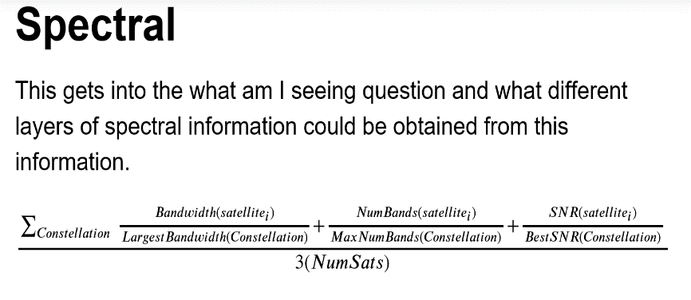
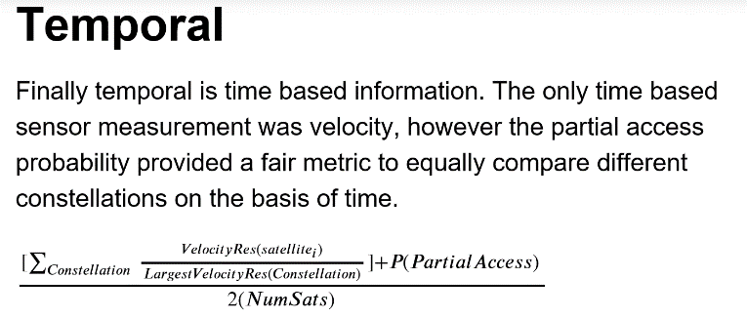
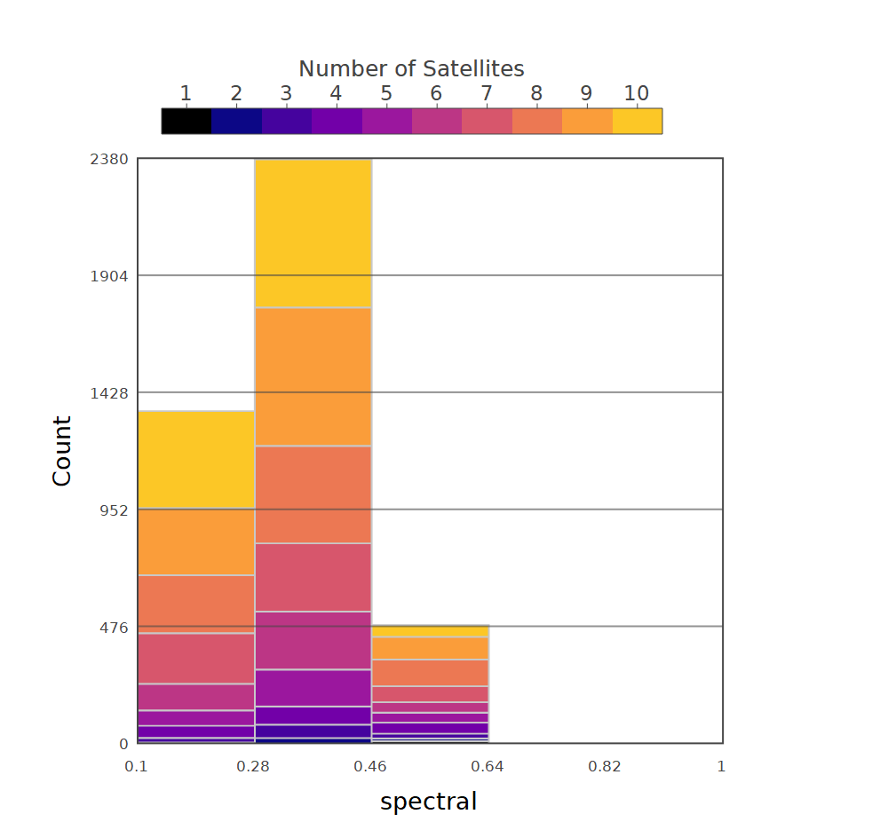
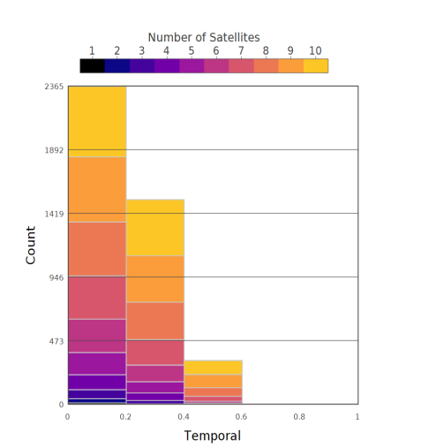
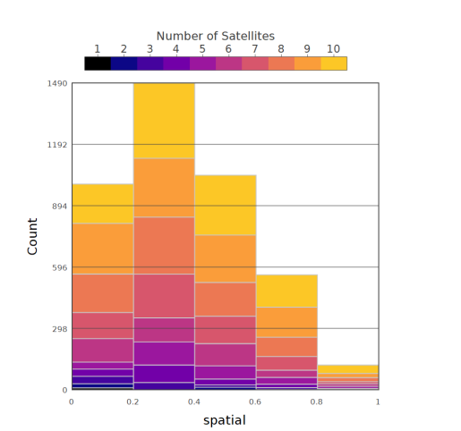

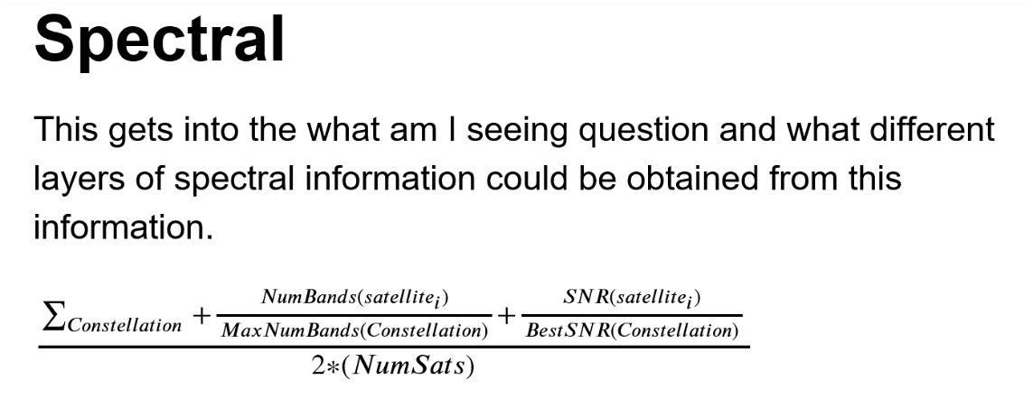
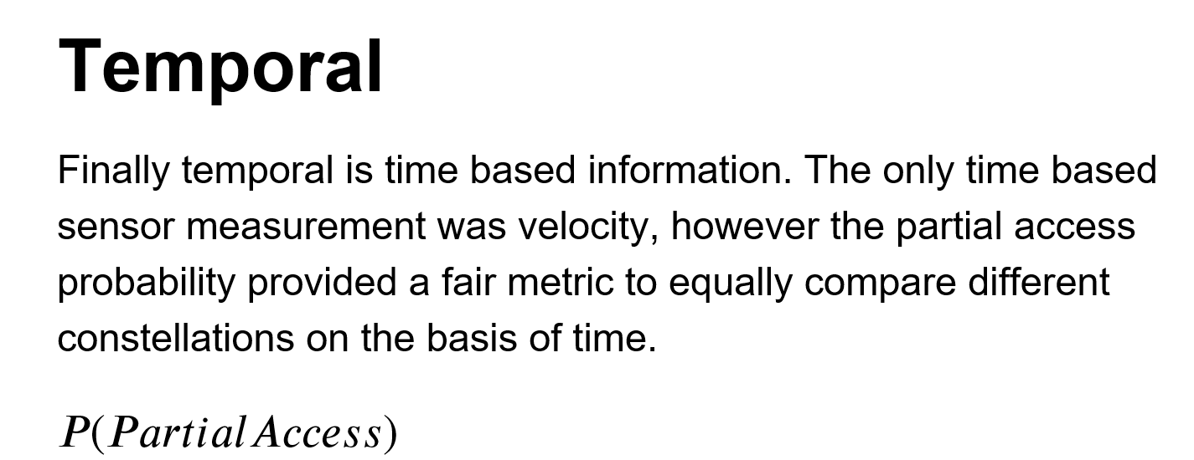

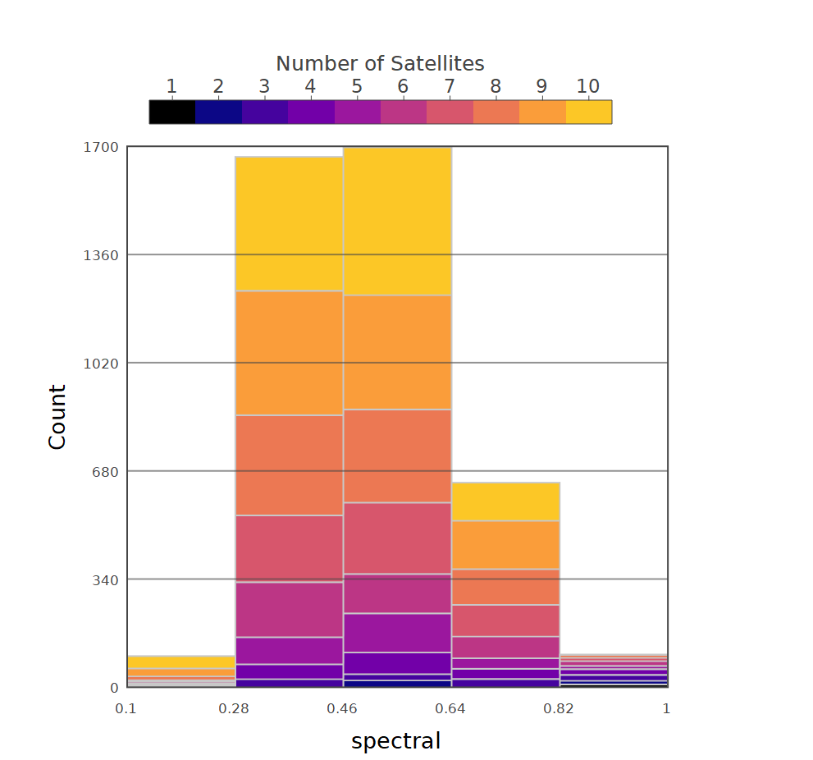
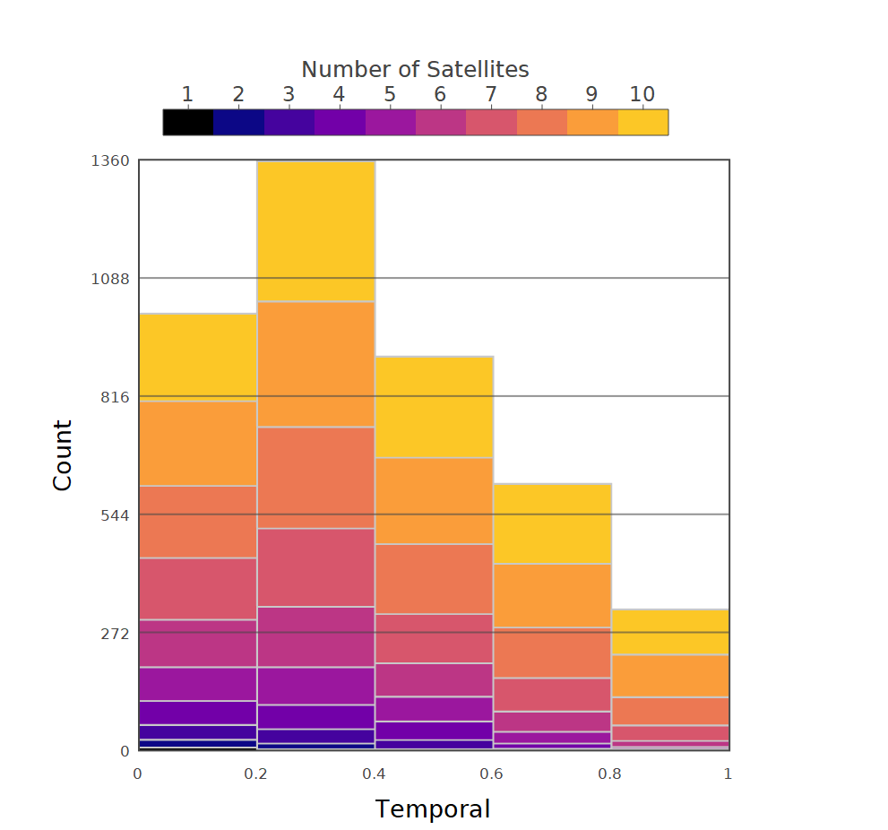
Binning Equations

Slide 17
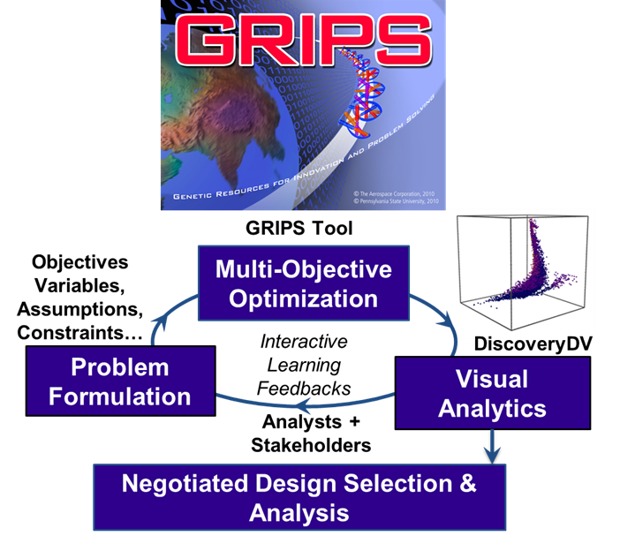
What is GRIPS?
The Tool: Searches for Optimal Solutions to a Problem
Many-objective optimizer
Parallelized computation
Ingests a variety of models
The Process: Searches for Optimal Problem Expressions
Structured, iterative process
Acknowledges many stakeholders, many objectives
Stakeholders learn about their decision space
Help decision makers arrive at consensus

Slide 18
Performance Modeling
Two basic aspects of any intelligence question are:
What is the probability of gaining access to a target? – Right place, right time
What is the probability of resolving characteristics about a target? – Right sensor, right target
Probability of Access can be defined by:
An event duration
Access/gaps to event location
Probability of Resolving can be defined by information theory:
Robert Harney* defined the information collected by a sensor across information types:
Intensity, color, range, velocity, RF, etc.
For a given sensor, the function defining its information collection is a summation of these types.
GRIPS (Genetic Resources for Innovation and Problem Solving)
An Aerospace Corporation tool
Used to design satellite architectures with diverse sensing types to simultaneously optimize probability of access and probability of resolving in terms of information theoretic metrics
Estimates the potential information that could be gathered by various numbers of satellites in different orbits, given ground scenarios
*Howerton, Phil. Managing Uncertainty and the Practice of Intelligence, [PowerPoint slides], 2019.
Harney, R.C. (1997). Information-based approach to performance estimation and requirements allocation in multisensory fusion for target recognition. Optical Engineering 36.

